Slide 1
MAPC Team 1
Richard Andreas
Ben Sui
Gonzalo Rosales
Jake Lee
Jeffrey Li

Slide 2
Motivation
MAPC: Metropolitan Area Planning Council
The MAPC would like to allocate funds to increase broadband access across the 101 Cities around Boston Metro Area
Based on 50+ features or variables
Number of Providers
Income
Ethnicity
Population
% of Unemployment
Etc.

Slide 3
Current Progress
Collected, preprocessed and filtered out data.
Created a local database to parse all data locally, instead of using in-memory data structures like dataframes.
Processed Data to filter out necessary parameters from the database to Python.
Analyzed data and mapped out relationships between broadband speeds with several variables
Max Providers
Median Income
Race

Slide 4
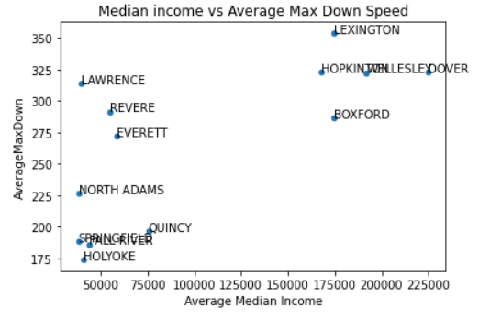
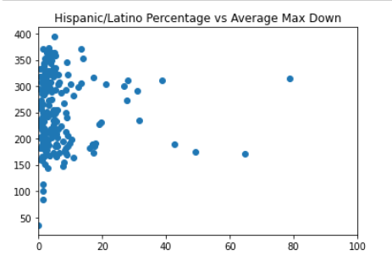
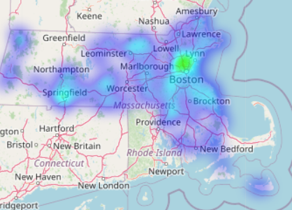

Slide 5
Next Steps
Creating heatmaps using max number of providers in each municipality
Map out several more variable relationships such as
Household Size
% unemployment
Create a large, cumulative scatter plot using Median Income and Maximum Advertised Upload and Download Speed

Slide 6
Limitations & Challenges
Data was very tedious to find and translate census and location data
Preprocessing and filtering of data needed as there are a lot of parameters that we do not need to evaluate
Since there are a lot of variables that contribute directly and indirectly to broadband speed, a lot of trial and error had to be done.
FCC Data seems very flat since the reported values are advertised instead of actual real-time values of Broadband data

Slide 7
Thank You
Any Questions?

